Slide 1

An introduction to teacher practitioner research: Workshop
Warwick/SJTU ELT Prof. Dev. Prog. 2018
Jason Anderson j.anderson.8@warwick.ac.uk

Slide 2
Principles and ground rules for the program
1. Mobile phones and other devices: Please use only when asked to do so, and only for learning purposes.
2. Laptops: Keep them closed. We will provide handouts and make PowerPoint slides available after the sessions. We prefer you to participate and interact with each other.
3. Eating and drinking: Only water in the classrooms.
4. Visiting the toilet: No need to ask permission. Be as quick as you can, but don’t take phones – use them only during breaks.
5. There is no such thing as a silly question – all questions are good.
6. Please respect breaktimes for the trainers – we need the time to prepare and rest.
7. There is no hierarchy in the training classroom – we are all equals.
Would you like to add anything?

Slide 3
Aims of session
To reflect on our successes as teachers
To share our successes with colleagues
To learn about exploratory action research: what is it and what does it involve
To learn about how one teacher solved a problem in her own classroom through exploratory action research
To identify puzzles and problems in our own classrooms
To share and compare our puzzles and problems
To begin developing questions for exploration

Slide 4

Thinking about success
Think about a recent successful experience / activity in your classroom. Imagine it in your mind’s eye.
Then tell another teacher:
How do you know it was successful?
What did you see, hear and feel that told you it was successful?

Slide 5
Put them in the correct order
Explore
[gather data]
Here you collect data to clarify the situation you identified. The important thing is to gather data carefully and later interpret it effectively.
  Analyse and reflect
  [answer questions on the basis of data]
  This is the stage where you analyse the entire process and reflect on what has happened. Here is where you will be able to clarify the puzzling or challenging situation you identified in order to later make an action plan if needed.
Plan to explore
[plan questions and how to get data]
This is the stage where you review your practice and decide on an area or situation you will focus on. Here you also think about the questions that need to be answered and you plan how to collect evidence to answer the questions being asked.
From: Smith and Rebolledo © 2018 A Handbook for Exploratory Action Research

Slide 6
Put them in the correct order
Observe [see what happens – with data]
You collect data either while the intervention is taking place or after it,
and you analyse it.
Reflect [interpret what occurred]
This is the stage where you interpret what has happened, reflecting particularly on the effects of the intervention and considering any further actions in the future.
Plan [to change]
In this stage you decide what to
change and plan how to collect
further data to see what happens.
Act [implement the change]
You apply the change (‘intervention’) you have planned.
From: Smith and Rebolledo © 2018 A Handbook for Exploratory Action Research

Slide 7
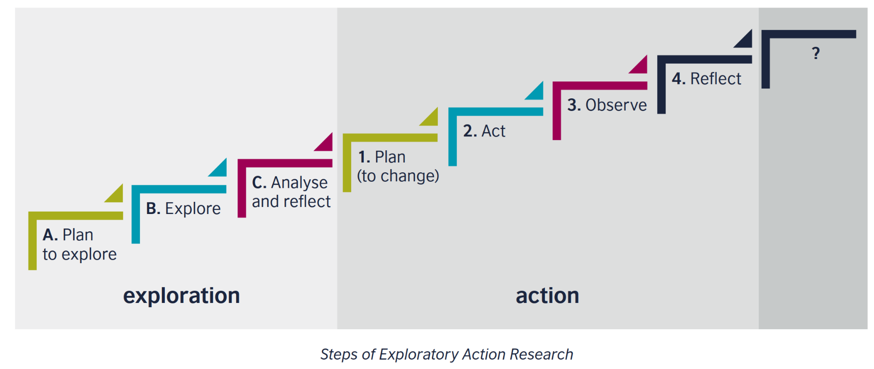
Steps of Exploratory Action Research
From: Smith and Rebolledo © 2018 A Handbook for Exploratory Action Research

Slide 8

Thinking about puzzles and problems
Think about a time in your recent teaching, when you noticed something that you didn’t understand, something that you found challenging, or something that caused a problem. Imagine it in your mind’s eye.
Then ask another teacher:
  What do you remember of the incident?
  Was there anything you didn’t understand, you found surprising, or strange?
  What problems (if any) did it cause?
  What did you see, hear and feel that told you so?

Slide 9
Research groups – from puzzles/problems to exploratory research questions
On Friday you will present an initial poster with your exploratory research questions (these can evolve!)
With the remaining time, think about possible questions:
  Questions that you can investigate during this programme
  Questions that you can investigate in the future in your classrooms

Slide 10
Aims of session revisited
To reflect on our successes as teachers
To share our successes with colleagues
To learn about exploratory action research: what is it and what does it involve
To learn about how one teacher solved a problem in her own classroom through exploratory action research
To identify puzzles and problems in our own classrooms
To share and compare our puzzles and problems
To begin developing questions for exploration

