Slide 1

Lesson planning frameworks
Warwick/SJTU ELT Prof. Dev. Prog. 2018
Jason Anderson j.anderson.8@warwick.ac.uk

Slide 2
Aims of session
Identify different lesson frameworks in ELT
Analyse key stages in these frameworks
Consider why these frameworks differ
Draw links between these frameworks, what we do and our teaching materials
Critically evaluate the appropriacy of these frameworks for our teaching

Slide 3
Discussion
Talk in pairs, making brief notes as you do:
Tell each other about a lesson you taught recently (e.g. a reading lesson, a grammar lesson, a writing lesson, etc.) and answer these questions:
  How many stages did your lesson have?
  What were these stages?
  Why were they in the order you chose?

Slide 4
Checking prior knowledge
A lesson framework is a prescriptive structure that we can use to plan the stages of our lesson in a specific, logical order.
Are any of these lesson ‘frameworks’ familiar to you?
  PPP
  TTT
  Task-based language teaching
  Receptive skills
  CAP
Do you know what stages they have?
E.g. the first stage in PPP is ‘Presentation’

Slide 5


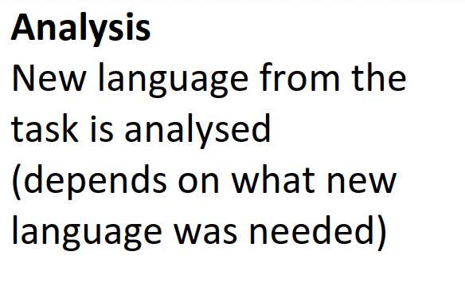
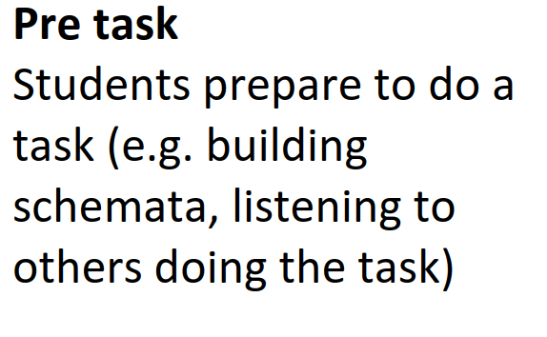
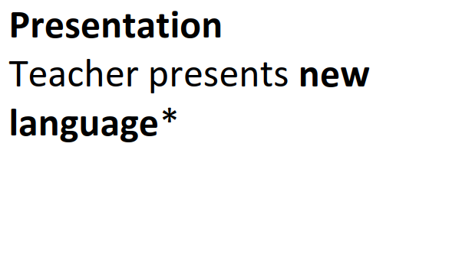
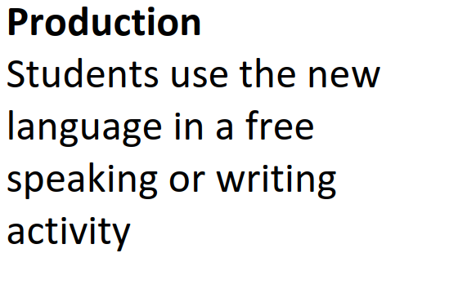
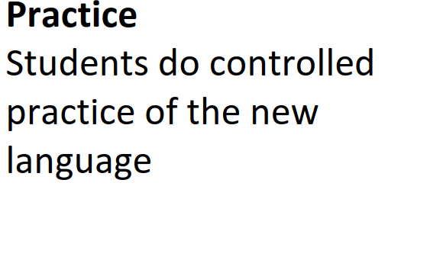
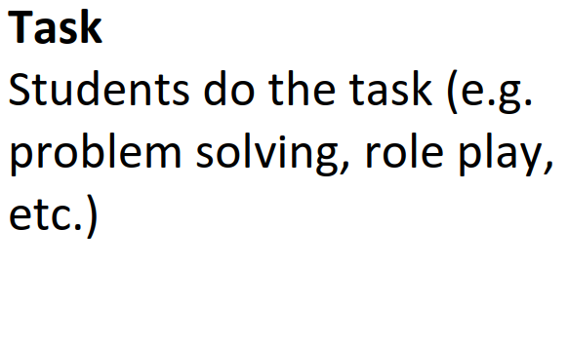
Groupwork task
You will receive cards for the different stages in the frameworks. Work in groups to put them together in the right order. Note: some of the stage names appear in more than one framework. Read carefully and think logically!

Slide 6
Groupwork task
The frameworks are:
PPP, TBLT, TTT, CAP, Receptive skills (reading and listening)

Slide 7
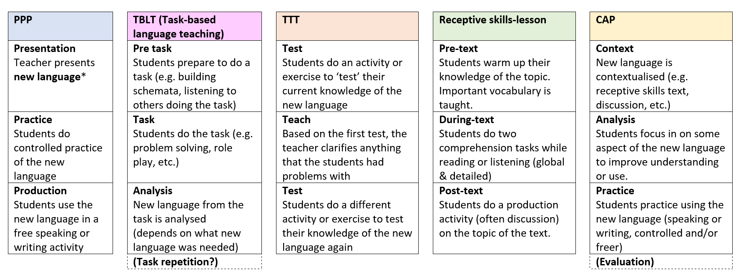
Lesson planning frameworks in ELT
What do they all have in common?
What do most of them have in common?
Why are there so many different options?

Slide 8
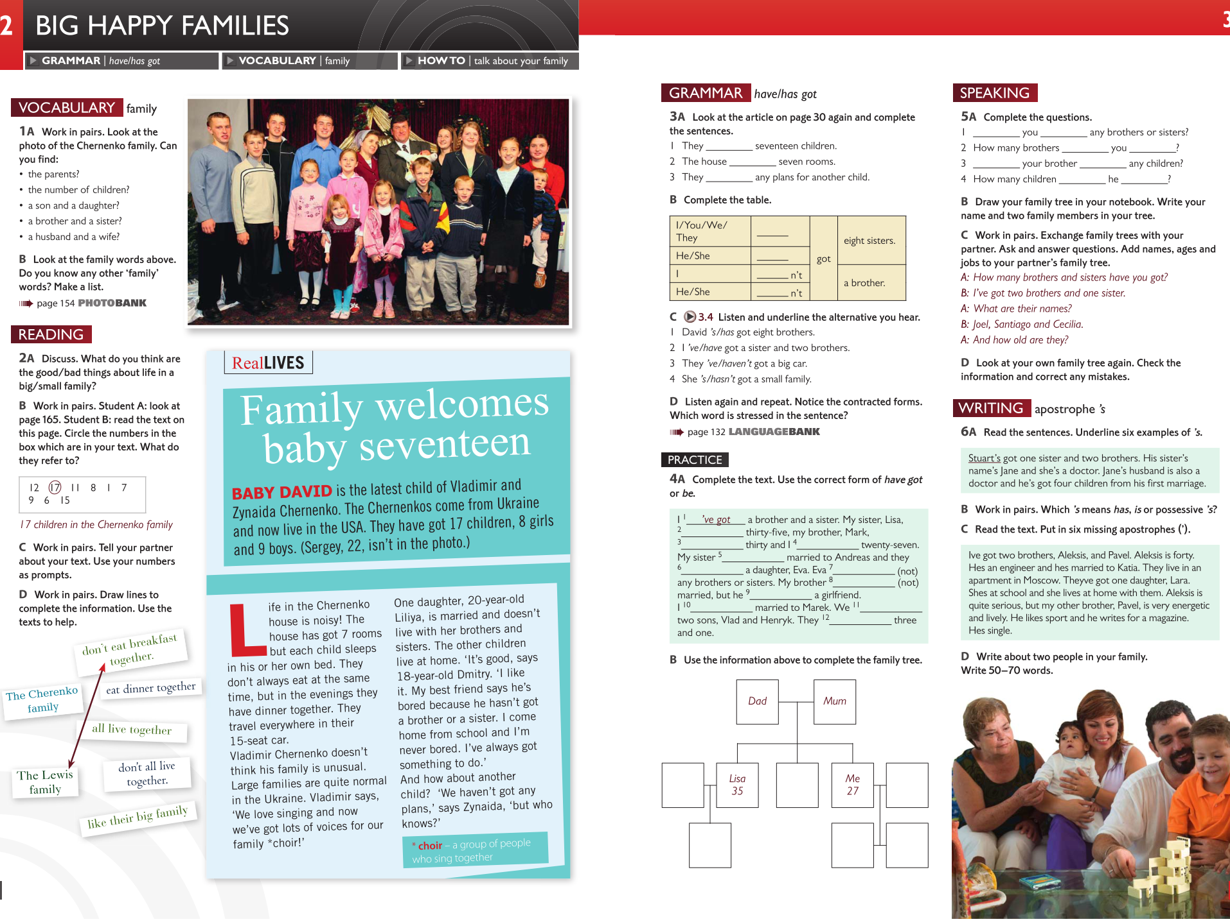
Analysis
Context
Practice
Speakout Elementary Eales & Oakes 2011 Pearson

Slide 9
Coursebook analysis – what frameworks can we find/develop?
Work in pairs.
Choose a coursebook that you use in your own classrooms.
Identify a ‘lesson’ in the coursebook.
What framework is implicit (assumed) in the lesson?
How could you adapt it to a different framework? (Make brief notes)
If time, do this for a second lesson.

Slide 10
Sharing
Present your ideas to a different pair.
Give feedback to each other on the different framework chosen:
  Does it improve the original lesson in your opinion?
  Would it work in your classroom?

Slide 11
Critical evaluation
General discussion:
Of all the frameworks you’ve met today, which ones are you most interested in trying out in your own classroom? Why?
What problems may you have trying them out? How can you deal with these problems?
Are there any other frameworks that you think should be added to the list?

Slide 12
Aims of session
Identify different lesson frameworks in ELT
Analyse key stages in these frameworks
Consider why these frameworks differ
Draw links between these frameworks, what we do and our teaching materials
Critically evaluate the appropriacy of these frameworks for our teaching
How did we do?

Slide 13
References / further reading
PPP
See: Anderson (2016a) Why practice makes perfect sense: The past, present and potential future of the PPP paradigm in language teacher education. ELTED 19: 14-22.
http://www.jasonanderson.org.uk/downloads/Anderson%202016%20Why%20practice%20makes%20perfect%20sense.pdf
Anderson (2016b) A potted history of PPP with the help of ELT Journal 71/2: 218-227.
https://academic.oup.com/eltj/article/71/2/218/2447419?guestAccessKey=2a6cb69a-aff6-423f-8879-91855886b37e
Task-based language teaching
See: Nunan (2004) Task-based Language Teaching. Cambridge: CUP. (on Moodle)
CAP
See: Anderson (2017a) Context, analysis, practice. IATEFL Voices 256: 4-5.
http://www.jasonanderson.org.uk/downloads/Anderson_2017_Context_analysis_and_practice.pdf
Anderson (2017b) CAP – Context, analysis, practice: A lesson planning model for language teacher education. IATEFL Teacher Training and Education SIG Newsletter 1(Spring): 15-18.
http://www.jasonanderson.org.uk/downloads/Anderson_2017_Context_analysis_practice-A_lesson_planning_model_for_language_teacher_education.pdf
Other frameworks?
Check out Jim Scrivener’s ARC, Jeremy Harmer’s ESA and others, here on Jason’s blog:
https://speakinggames.wordpress.com/2015/07/20/three-is-the-magic-number-the-tefl-paradigms-quiz/
Also see here: www.jasonanderson.org.uk

Slide 14
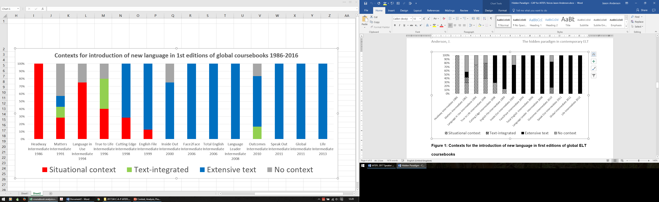
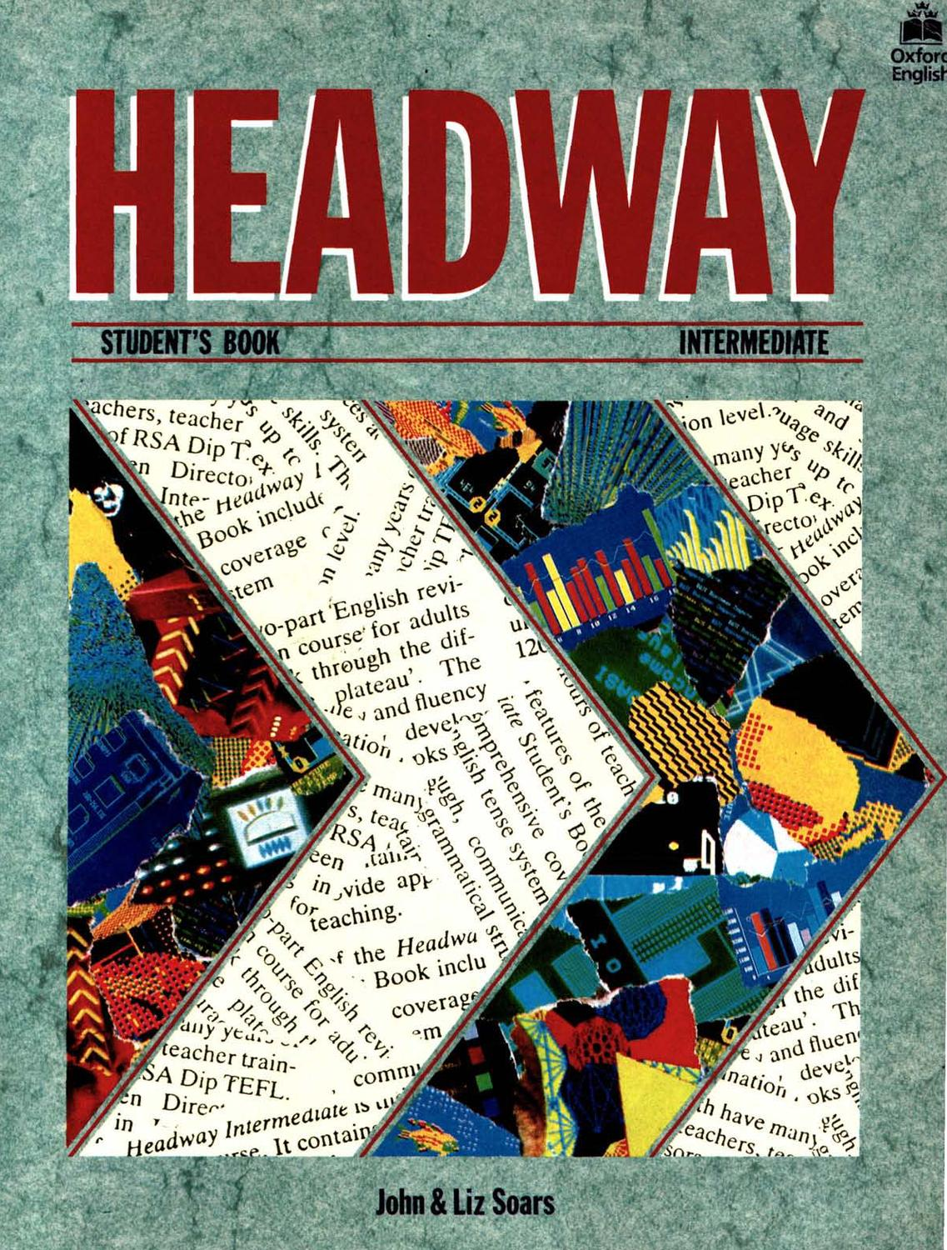

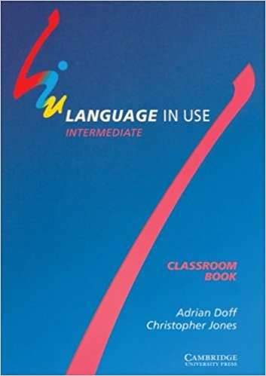





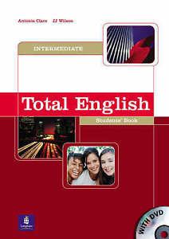
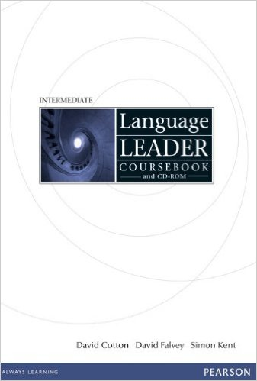




Contexts for the introduction of new language in 1st editions of ELT coursebooks
Image-supported
1986 2000 2013

Slide 15
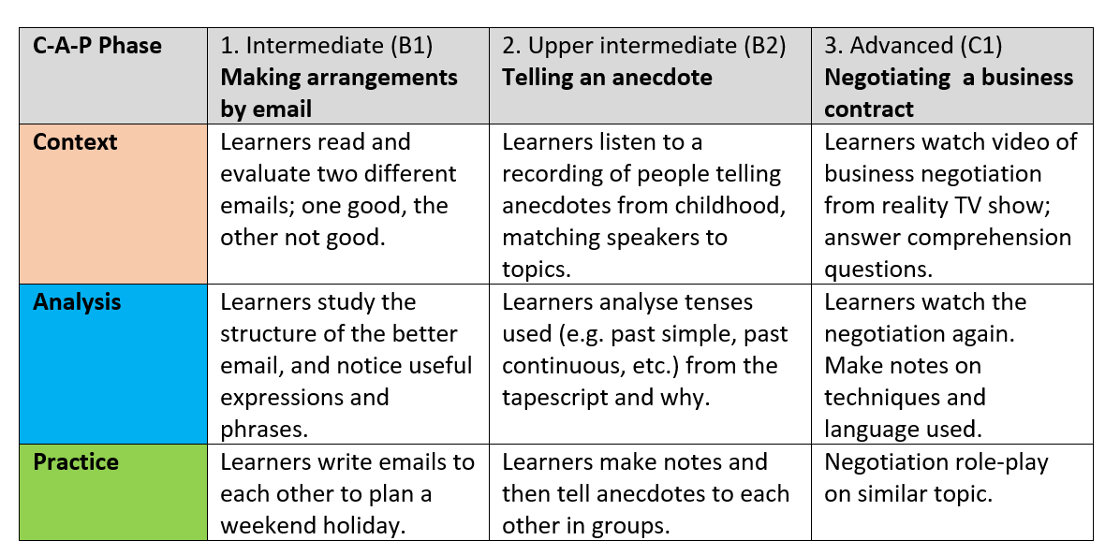
3 ‘lesson frameworks’ using CAP
From Anderson, J. (2017) Trinity CertTESOL Companion

